Slide 1

DATA NETWORKS
LESSON 6
Data Link Layer

Slide 2
Data Link Layer
Learning outcomes:
Understand principles of the Data Link Layer
Multiple Access Protocols
Data Link Layer protocols
Computer Networking: A Top-Down Approach. 7th edition. Jim Kurose, Keith Ross – Pearson (2017).

Slide 3
Data Link Layer
The second Layer of the OSI Model
• Responsible for data transfer between two devices on the same network link (adjacent devices).
• The Data Link Layer provides reliable communication between two directly connected devices over a physical medium.
Uses frames to transmit data
Uses MAC addresses for device identification on a LAN

Slide 4
Data Link Layer
Data Link Layer services:
Framing: Breaking down the raw bitstream from the physical layer into units called frames.
Encapsulation: Adds header and trailer information needed for delivery and error checking.
Addressing: Using MAC addresses to ensure data is delivered to the correct device on local network.
Error detection: Detects transmission errors in frames
Error Correction: Correct detected error via re-transmission of corrupted frames or after timeout
Flow control: Manages the rate at which data is transmitted between 2 adjacent devices on a LAN to prevent congestion.
Encoding: Converting data into signals suitable for transmission (electrical signals, light pulses, radio signals)

Slide 5








Data Link layer: Introduction
Terminologies:
Any device that is connected to a network and can send, receive, or redistribute data: nodes
Communication channels that connect adjacent nodes along the communication path: links
Wired links
Wireless links
Unit of data: frame
data-link layer has the responsibility of
transferring datagrams from one node
to physically adjacent node over a link

Slide 6
Data Link layer: Sub-layers
2 sub-layers:
Logical Link Control (LLC) Layer
Manages communication between Layers (Layer2 ↔ Layer 3)
Provides flow control, frame synchronization and error checking.
Media Access Control (MAC) Layer
Responsible for moving frames between devices on the same network across a shared channel.
Controls how devices access the shared transmission medium
This is done with the use of a multiple access protocol to coordinate the access to a shared channel.
Uses MAC addresses for identification

Slide 7
Data Link layer: Sub-layers
Logical Link Control (LLC) Layer
Error Control:
Detects and handles errors in frames
May request retransmission of corrupted frames
Ensures reliable communication
Flow Control:
Controls the rate of data transmission
Prevents the receiver from being overloaded
Ensures sender and receiver operate at compatible speeds
Frame Synchronization:
Ensures the receiver can identify the start and end of each frame
Maintains proper alignment of data during transmission
…….
Error Control → “Is the data correct?”
Flow Control → “Am I sending too fast?”
Frame Sync → “Where does the frame start and end?”

Slide 8
Data Link layer services
1) Reliable delivery between adjacent nodes
Ensures reliable communication between adjacent nodes
Uses techniques similar to upper layers e.g. Transport layer– using the two mechanisms = Acknowledgement and Timeouts (retransmit).
An Acknowledgement (ACK) control frame is sent back to the sender from the receiver to confirm successful receipt of a frame.
If the sender does not receive an ACK from the receiver after a reasonable amount of time (Timeout), then it retransmits the original frame.

Slide 9
Data Link layer services
Reliable delivery between adjacent nodes
Error Handling:
Frames may become corrupted during transmission and some errors are too severe to correct.
These Corrupted frames are discarded
A Data Link-level protocol must recover lost frames using retransmission.
Link Type Comparison:
Wired Links: have a low error rate (e.g. Fibre, Ethernet)
Wireless links: have a high error rate due to more interference and noise (e.g microwave, wifi, radio and Cellular (mobile) links)

Slide 10
Data Link layer services
2) Flow control:
Imposes a flow control mechanism to avoid overwhelming the receiver.
It controls the pacing between adjacent sending and receiving nodes by telling the sender how much data it can transmit before it must wait for an acknowledgement from the receiver.
Any receiving device has a limited speed at which it can process incoming data and a limited amount of memory (buffer) to store and process incoming data.
If the buffer begins to fill up, the receiver must be able to tell the sender to halt or pause transmission until it can receive again.

Slide 11
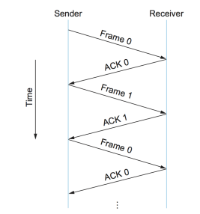
Data Link layer services
The two flow control mechanisms:
Stop and Wait Flow Control
Sender transmits one frame at a time
Waits for ACK before sending the next frame
Simple but inefficient (slow)

Slide 12
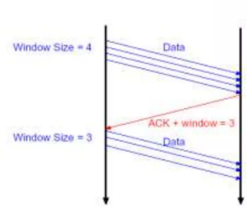
Data Link layer services
The two flow control mechanisms:
Sliding Window Flow Control
Sender can send multiple frames before receiving ACKs
Receiver uses a window size to control how many frames can be sent
More efficient and faster

Slide 13
Data Link layer services
3) Error Detection and Correction
Uses mechanisms to detect errors in frames, so that corrective action can be taken.
Error detection:
Receiver detects the presence of errors in received frames
If an error is detected - frame is discarded and retransmission of damaged frames is requested
Errors are caused by signal attenuation (signal weakens over distance) and noise/interference (distorts the signal).

Slide 14
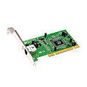
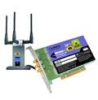

Where is the Data link layer implemented?
In every host
Data Link layer implemented in “adapter” (Network Interface Card) - A piece of hardware
that connects a node to a link.
Ethernet card, 802.11 card;
implements link, physical layer
Network adaptors, along with device drivers running in the node’s operating system, typically implement the data link level.
application
transport
network
link
cpu
memory
link
physical
host
bus
(e.g., PCI)
controller
physical
transmission
network adapter
card

Slide 15
Adaptors communicating
datagram
datagram
controller
controller
sending host
receiving host
datagram
frame
sending side:
encapsulates datagram in frame
adds error checking bits, flow control, etc.
receiving side
looks for errors, flow control, etc.
extracts datagram, passes to upper layer at receiving side

Slide 16


Multiple Access Links & Protocols
Two types of network “links”:
point-to-point
A single sender at one end of the link and a single receiver at the other end of the link
E.g. point-to-point link between an Ethernet switch and host
broadcast (shared transmission medium)
Multiple sending and receiving nodes all connected to the same, single, shared broadcast channel.
E.g. Ethernet (802.3), Wireless LAN (802.11)
shared wire (e.g.,
cabled Ethernet)
shared RF
(e.g., 802.11 WiFi)
shared RF
(satellite)

Slide 17
Multiple Access Links & Protocols
Common mediums “links”:
Ethernet
Wi-Fi
Bluetooth
Fibre-Distributed Data Interface (FDDI)
Token ring

Slide 18
Multiple Access Links & Protocols
Data Link Layer problem
How to coordinate the access of multiple sending and receiving devices to a shared broadcast channel = Multiple access problem
How?
Two or more devices may transmit frames at the same time.
When this happens, a node may receive multiple frames at the same time causing the transmitted frames to collide at the receiver’s end = Collision!
Typically, when there is a collision, the receiving nodes cannot decode the frames that were transmitted as the signals of the colliding frames become corrupted.
Thus, all the frames involved in the collision are lost!

Slide 19
Multiple Access Protocols
Multiple Access Protocols were implemented to coordinate the data transmission of devices on a shared network to minimize or avoid collisions.
It is a distributed algorithm that determines how devices share a channel, i.e determines when a device can transmit.
Communication about channel access/sharing is done over the same shared channel.

Slide 20
Multiple Access Protocols
GOAL: An ideal multiple access protocol is :
Efficient
If only one device wants to send → it can use the full channel capacity.
2. Fair
If multiple devices want to send → each gets a fair share of the channel
3. Fully decentralized:
no special node to coordinate transmissions
4. Simple
Rules are easy to implement and follow

Slide 21
Multiple Access Protocols
There are three Categories:
Channel partitioning protocols
Random access protocols
Taking-turns protocols.
NB!! Bandwidth
The amount of data a channel can carry per second
Bandwidth = channel capacity = how much data can be sent over the link/channel per second

Slide 22
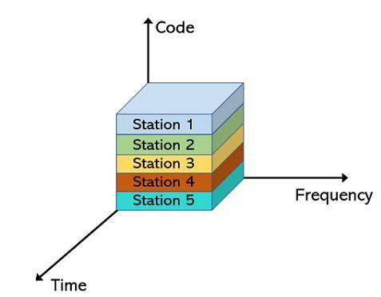
1. Channel Partitioning Protocols
Used to partition/divide a shared channel’s bandwidth so multiple nodes can transmit without collisions.
Allocate a dedicated partition (“piece”) of the channel to a node for exclusive use.
Ensures the channel is shared efficiently and fairly.
Techniques:
Time Division Multiple Access (TDMA)
Frequency Division Multiple Access (FDMA)
Code Division Multiple Access (CDMA)

Slide 23
TDMA: time division multiple access
The channel is divided into time slots.
Each station(device) gets a fixed time slot in each round
Unused slots remain idle
example:
LAN with 6 Stations/devices → 6 Timeslots
Each device is assigned one fixed slot to transmit per round
Only stations 1,3,4 have data to send → Slots 2,5,6 are idle
Round 1
Round 2
6-slot
frame
6-slot
frame
1
3
4
1
3
4

Slide 24
FDMA: frequency division multiple access
Primarily in wireless communication (Cellular networks – GSM/2G)
channel is divided into frequency bands
each station gets assigned a fixed frequency band to transmit on
unused frequency bands remain idle
example:
LAN with 6-stations
Stations 1,3,4 have data to send
frequency bands 2,5,6 remain idle
NB! A frequency band is a specific range of electromagnetic frequencies allocated for transmitting signals e.g, 900 MHz band in 2G networks
time
frequency bands
FDM cable

Slide 25
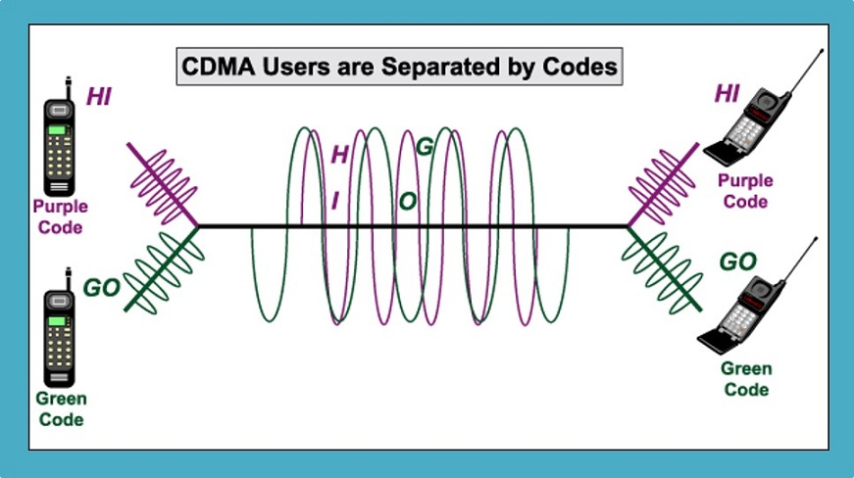
CDMA: code division multiple access
The channel spectrum is divided into unique codes.
Code = unique digit used to separate the signals of the different devices
Each station(device) is assigned a unique code by the network.
All station use the full available spectrum simultaneously instead of each having its’ own frequency.
Recommended for voice and data communications.
Used in cellular networks (UMTS – 3G)

Slide 26
2. Random access protocols
The channel is not divided, nodes transmit at random.
Each node transmits at the full rate of the channel.
Collision handling:
When there is a collision, each node involved in the collision waits a random delay (time) before retransmitting the frame through without a collision.
Each node chooses its delay time independently → this reduces the chance of repeated collisions. Makes it possible for the nodes pick different delays and can retransmit without a collision.
Common Random-access protocols:
Pure ALOHA
Slotted ALOHA
CSMA (Carrier Sense Multiple Access)

Slide 27
Random Access Protocols: Carrier Sense Multiple Access (CSMA)
A widely used Multiple Access Protocol.
Developed to decrease the chances of collisions when two or more nodes start transmitting frames at the same time on the same channel.
A node listens to the channel before transmitting - carrier sensing!
If a node senses a frame is being transmitted on the channel, it waits for a short period until it detects no transmissions on the channel, and then it can begin transmission – collision avoidance.
During transmission the node continues listening:
If it detects that another node is transmitting an interfering frame, it stops transmitting.
Waits a random time, then listens and transmits again if the channel is free - collision detection.

Slide 28
Carrier Sense Multiple Access
Variations of CMSA protocols:
Collision Avoidance (CSMA/CA)
Collision Detection (CSMA/CD)
CSMA Variations
depends on the transmission medium

Slide 29
CSMA/CD (Collision Detection)
Collision Detection was added to the CSMA protocol because nodes continued to transmit even though a collision had occurred.
How it works:
A node detects a collision and stops transmitting immediately → reduces wasted channel time
Node sends a jam signal to inform the other nodes that they must not transmit.
This helps prevents nodes from sending a full, damaged frame.
Collision detection:
Collisions are detected within a short time
Developed for Wired Ethernet (IEEE 802.3
Human Analogy
If someone else begins talking at the same time, stop talking!

Slide 30
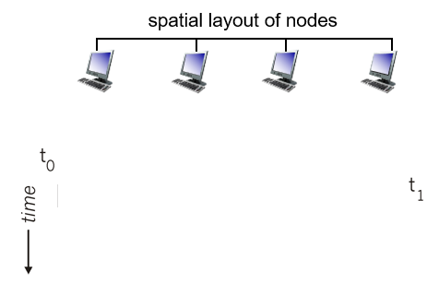
CSMA/ CA (Collision Avoidance)
Nodes listens to the channel before transmitting:
if channel is idle: transmit entire frame
if channel busy, wait until channel is idle to transmit (delay)
Developed for wireless networks 802.11
HUMAN ANALOGY
Listen before speaking
Don’t interrupt others!
collisions can still occur: due to propagation delay → when two nodes are far apart and don’t hear each other’s transmission.
note: distance & propagation delay play a role in determining collision probability.

Slide 31
3. “Taking turns” protocols
Nodes take turns to transmit on the channel
Nodes with more to send can take longer turns
Examples of taking turns protocols:
Polling protocols
Token-passing protocols

Slide 32

Polling protocols
Requires one of the nodes to be designated as a master node.
The master node polls each of the nodes in a round-robin fashion “inviting” them to transmit in turns
Collisions and empty slots are eliminated
More efficient compared to random-access protocols
data
poll
master
data
slaves

Slide 33
Token-passing protocols
Token: a small special frame that gives a node permission to transmit on the network
Token passed from one node to next sequentially in a network.
Node holding the token is granted permission to transmit data.
Only one node can send at a time → avoids collisions on the shared medium
Token passing is decentralized and highly efficient.
T
T
(nothing
to send)
data

Slide 34
Data Link Layer Addressing
MAC (physical or Ethernet) address:
function: Used to uniquely identify and to deliver frames between devices on the same Local network
Non-routable address → only works within the same LAN
48-bit MAC address burned in into the NIC of a device by the manufacturer e.g.: 1A-2F-BB-76-09-AD
MAC Structure
First 3 bytes = Organizational Unit Identifier (OUI) → identifies the manufacturer
Last 3 bytes = NIC number → uniquely identifies the device
E.g. 00-0C-0E-15-2A-D7
OUI NIC

Slide 35

LAN addresses
Each adapter on LAN has unique LAN address to allow
Local communication.
1A-2F-BB-76-09-AD
LAN
(wired or
wireless)
NIC adapter
71-65-F7-2B-08-53
58-23-D7-FA-20-B0
0C-C4-11-6F-E3-98

Slide 36
Data Link Layer Protocols
Address Resolution Protocol (ARP)
Point-To-Point Protocol (PPP)
Ethernet

Slide 37
Address Resolution Protocol (ARP)
Allows devices to Map IP addresses to MAC addresses
Necessary because on a LAN devices communicate using MAC addresses and not IP addresses
When a device wants to communicate with another device on the LAN, it sends an ARP request to the switch to find the MAC address
Each device keeps an ARP Table of devices it recently communicate with – Speeds up communication by looking up the table instead of asking every time
MAC addresses are cached in the ARP Table.
Two types of ARP cache entries:
Static ARP Cache Entries
Dynamic ARP Cache Entries

Slide 38
ARP: Cached Entries
Static ARP Cache Entries
These are address mappings that are manually added to the cache table for a device by the administrator and are kept in the cache permanently.
These entries are best used for devices that a given device communicates with regularly. E.g. local router, file-server.
Dynamic ARP Cache Entries
These are address mappings that are added to the cache table through self-learning as a result of completed ARP resolutions.
They are kept in the cache only for some time and are then removed.
These are used most often because they are automatic and don't require administrator intervention.

Slide 39
ARP: Address Resolution (IP to MAC )
How?
Let’s say a sending host needs to obtain the MAC address of the destination given the IP address.
If a device knows the MAC in its ARP table → it uses it
If not, it sends an ARP packet to ask the network for the MAC address of the destination IP
The ARP query asks all devices on the LAN: “Who has this IP?”
The device with that IP responds with its MAC address
The sending devices caches the IP + MAC in the ARP table
The sending device transmits the data to the receiver using the MAC address

Slide 40




ARP: Address Resolution (IP to MAC )
Question: how to determine
interface’s MAC address, knowing its IP address?
ARP table: each IP node on LAN has a table
IP/MAC address mappings for some LAN nodes:
< IP address; MAC address; TTL>
TTL (Time To Live): time after which address mapping will be forgotten (typically 20 min)
137.196.7.78
1A-2F-BB-76-09-AD
137.196.7.23
137.196.7.14
LAN
71-65-F7-2B-08-53
58-23-D7-FA-20-B0
0C-C4-11-6F-E3-98
137.196.7.88

Slide 41
ARP protocol: Caching
Node A caches (saves) IP-to-MAC address pair in its ARP table until information becomes old (times out = 10 to 20 mins)
A wants to send datagram to B
B’s MAC address not in A’s ARP table.
A broadcasts ARP query packet, containing B's IP address
destination MAC address = FF-FF-FF-FF-FF-FF
all nodes on LAN receive ARP query
B receives ARP packet, replies to A with its MAC address
frame sent to A’s MAC address (unicast)

Slide 42
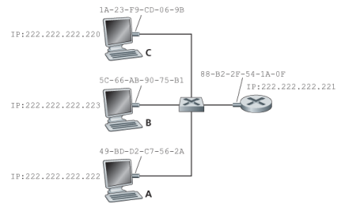
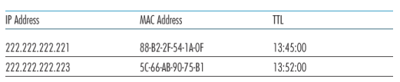
EXAMPLE: ARP Table
Nodes on a LAN
ARP Table

Slide 43

Ethernet Frame Structure
sending adapter encapsulates IP datagram (or other network layer protocol packet) in Ethernet frame
Preamble: used to synchronize receiver and sender clock rates
Dest/Src addresses: contains the MAC address of the destination and source adapter
Type: indicates higher layer protocol (mostly IP but others possible, e.g., Novell IPX, AppleTalk)
CRC: error detection
Data field: carries the IP datagram (46 to 1,500 bytes). The maximum transmission unit (MTU) of Ethernet is 1,500 bytes.

Slide 44
THE END
THANK YOU

